Slide 1
Gaussian Mixture Models
Most slides come from http://www.inf.ed.ac.uk/teaching/courses/asr/2020-21/asr05-hmm-algorithms.pdf
Ying shen
School of software engineering
Tongji university

Slide 2
Content
Univariate and multivariate Gaussians
Gaussian mixture models
GMM estimation with the EM algorithm
Using GMMs with HMMs

Slide 3
Content
Univariate and multivariate Gaussians
Gaussian mixture models
GMM estimation with the EM algorithm
Using GMMs with HMMs

Slide 4


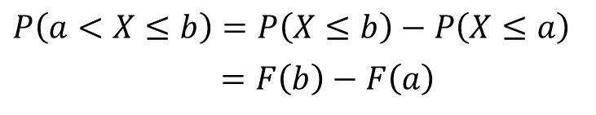
Background: cdf
Consider a real valued random variable $X$
  Cumulative distribution function (cdf) $F(x)$ for $X$:
  To obtain the probability of falling in an interval we can do the following:
$$F(x) = P(X≤x)$$
$$P\left(a<X≤b\right)=P\left(X≤b\right)−P\left(X≤a\right)$$
$$=F\left(b\right)−F\left(a\right)$$

Slide 5

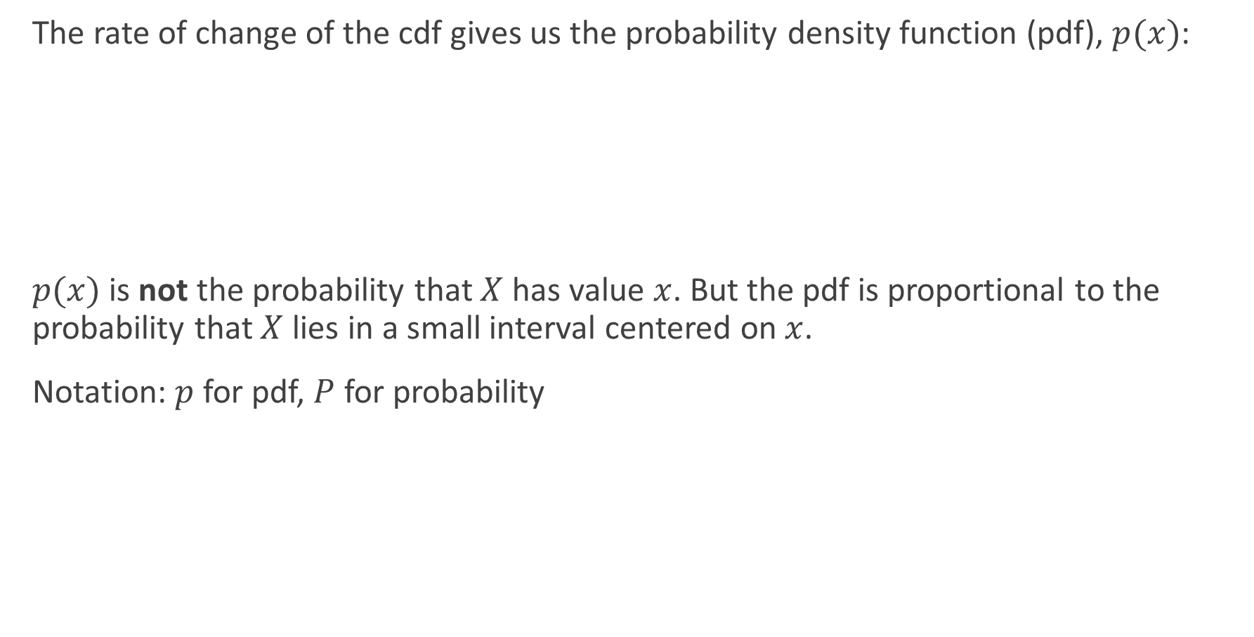
Background: cdf
The rate of change of the cdf gives us the probability density function (pdf), $p(x)$:
$p(x)$ is not the probability that $X$ has value $x$. But the pdf is proportional to the probability that $X$ lies in a small interval centered on $x$.
Notation: $p$ for pdf, $P$ for probability
$$p\left(x\right)=\frac{d}{dx}F\left(x\right)=F^{′}\left(x\right)$$
$$F\left(x\right)=\int_{−∞}^{x}{p\left(x\right)dx}$$

Slide 6
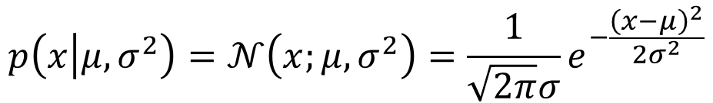
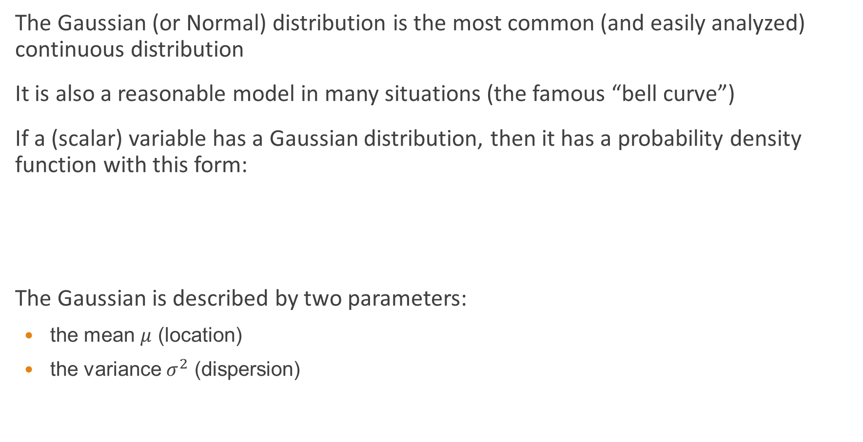
The Gaussian distribution (univariate)
The Gaussian (or Normal) distribution is the most common (and easily analyzed) continuous distribution
It is also a reasonable model in many situations (the famous “bell curve”)
If a (scalar) variable has a Gaussian distribution, then it has a probability density function with this form:
The Gaussian is described by two parameters:
  the mean $μ$ (location)
  the variance $σ^{2}$ (dispersion)
$$p\left(x | μ,σ^{2}\right)=𝒩\left(x;μ,σ^{2}\right)=\frac{1}{\sqrt{2π}σ}e^{−\frac{{\left(x−μ\right)}^{2}}{2σ^{2}}}$$

Slide 7


Plot of Gaussian distribution
Gaussians have the same shape, with the location controlled by the mean, and the spread controlled by the variance
One-dimensional Gaussian with zero mean and unit variance ($μ=0, σ^{2}=1$):
$$μ=0$$
$$σ^{2}=1$$

Slide 8
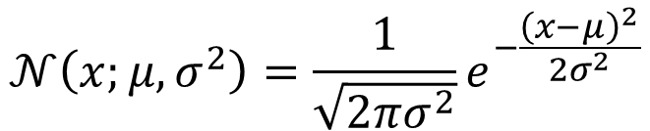


Properties of the Gaussian distribution
$$𝒩\left(x;μ,σ^{2}\right)=\frac{1}{\sqrt{2πσ^{2}}}e^{−\frac{{\left(x−μ\right)}^{2}}{2σ^{2}}}$$
$$μ=0$$
$$σ^{2}=1$$
$$μ=0$$
$$σ^{2}=2$$
$$μ=0$$
$$σ^{2}=4$$

Slide 9


Parameter estimation
Estimate mean and variance parameters of a Gaussian from data $x_{1},x_{2},…,x_{T}$
Use the following as the estimates:
$$\hat{μ}=\frac{1}{T}\sum_{t=1}^{T}{x_{t}}$$
$${\hat{σ}}^{2}=\frac{1}{T}\sum_{t=1}^{T}{{\left(x_{t}−\hat{μ}\right)}^{2} }$$

Slide 10

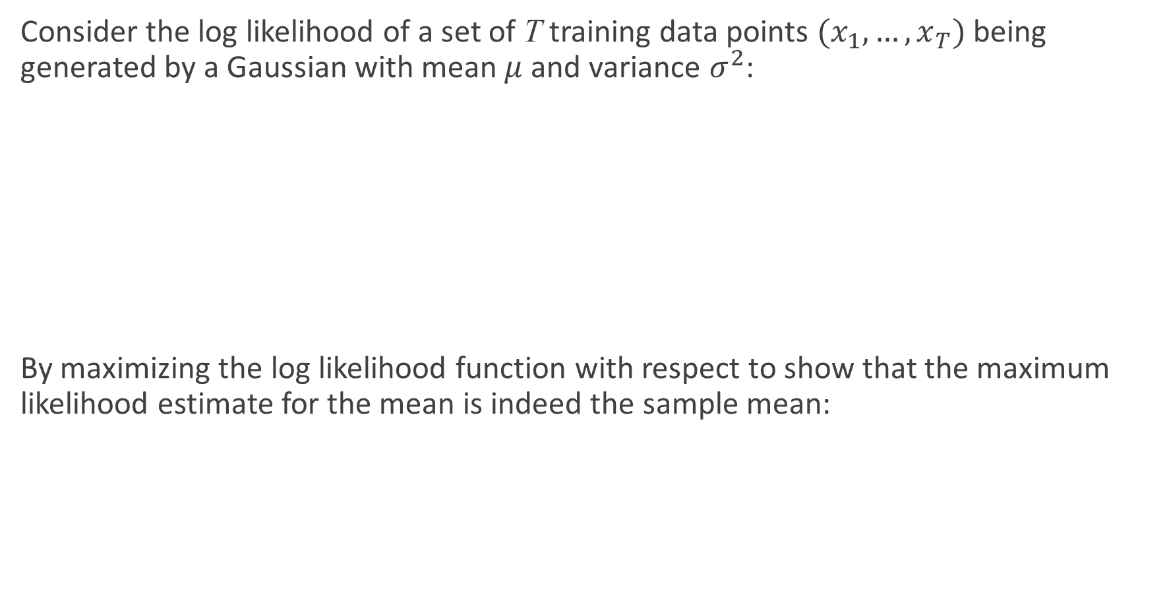
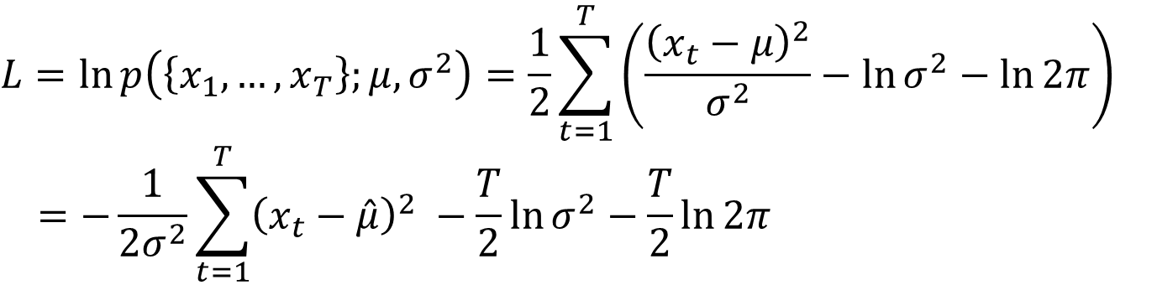
Exercise – maximum likelihood estimation (MLE)
Consider the log likelihood of a set of T training data points $(x_{1},…, x_{T})$ being generated by a Gaussian with mean $μ$ and variance $σ^{2}$:
By maximizing the log likelihood function with respect to show that the maximum likelihood estimate for the mean is indeed the sample mean:
$$L=\ln{p\left(\left\{x_{1},…,x_{T}\right\};μ,σ^{2}\right)}=\frac{1}{2}\sum_{t=1}^{T}{\left(\frac{{\left(x_{t}−μ\right)}^{2}}{σ^{2}}−\ln{σ^{2}}−\ln{2π}\right)}$$
$$=−\frac{1}{2σ^{2}}\sum_{t=1}^{T}{{\left(x_{t}−\hat{μ}\right)}^{2} }−\frac{T}{2}\ln{σ^{2}}−\frac{T}{2}\ln{2π}$$
$$μ_{MLE}=\frac{1}{T}\sum_{t=1}^{T}{x_{t}}$$

Slide 11
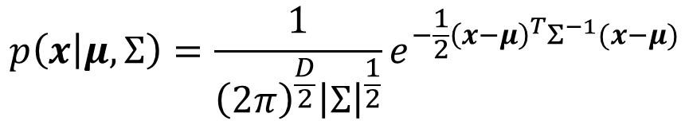
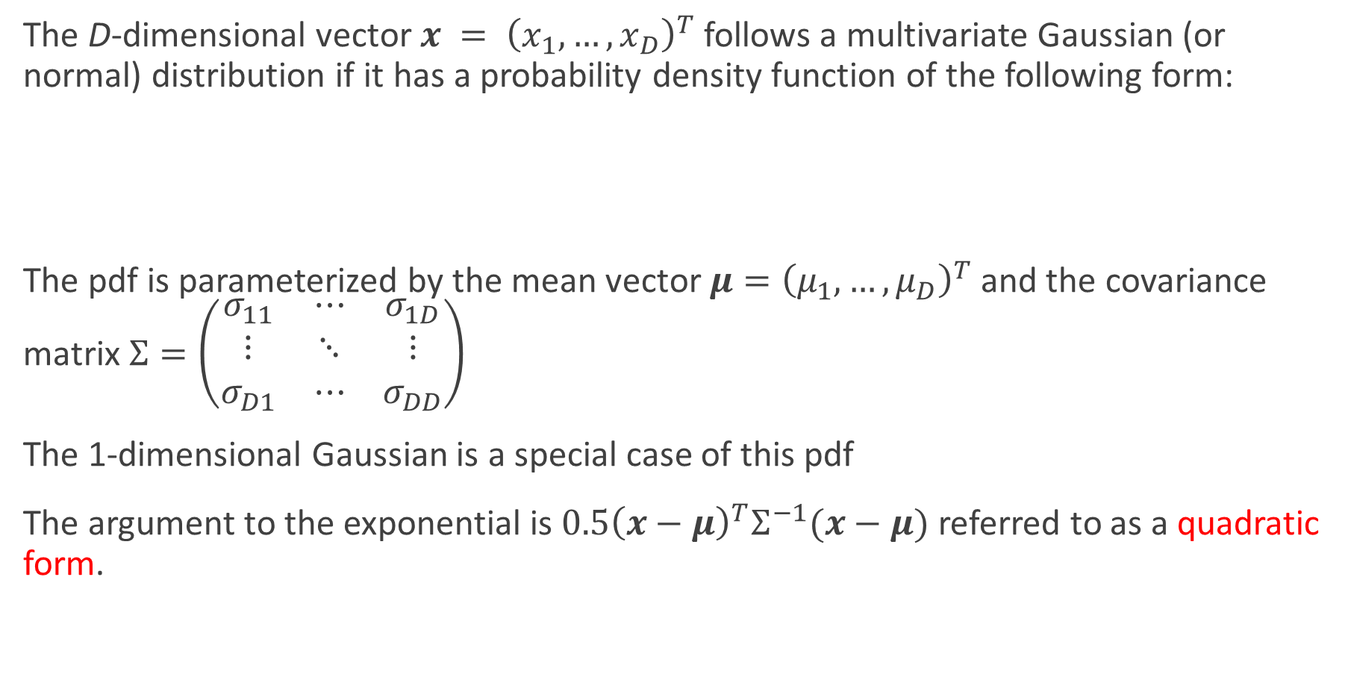
The multivariate Gaussian distribution
The D-dimensional vector $x = {\left(x_{1},…,x_{D}\right)}^{T}$ follows a multivariate Gaussian (or normal) distribution if it has a probability density function of the following form:
The pdf is parameterized by the mean vector $μ={\left(μ_{1},…,μ_{D}\right)}^{T}$ and the covariance matrix $Σ=\left(\begin{matrix}σ_{11} & ⋯ & σ_{1D} \\ ⋮ & ⋱ & ⋮ \\ σ_{D1} & ⋯ & σ_{DD}\end{matrix}\right)$
The 1-dimensional Gaussian is a special case of this pdf
The argument to the exponential is $0.5{\left(x−μ\right)}^{T}Σ^{−1}(x−μ)$ referred to as a quadratic form.
$$p\left(x | μ,Σ\right)=\frac{1}{{\left(2π\right)}^{\frac{D}{2}}{\left|Σ\right|}^{\frac{1}{2}}}e^{−\frac{1}{2}{\left(x−μ\right)}^{T}Σ^{−1}(x−μ)}$$

Slide 12

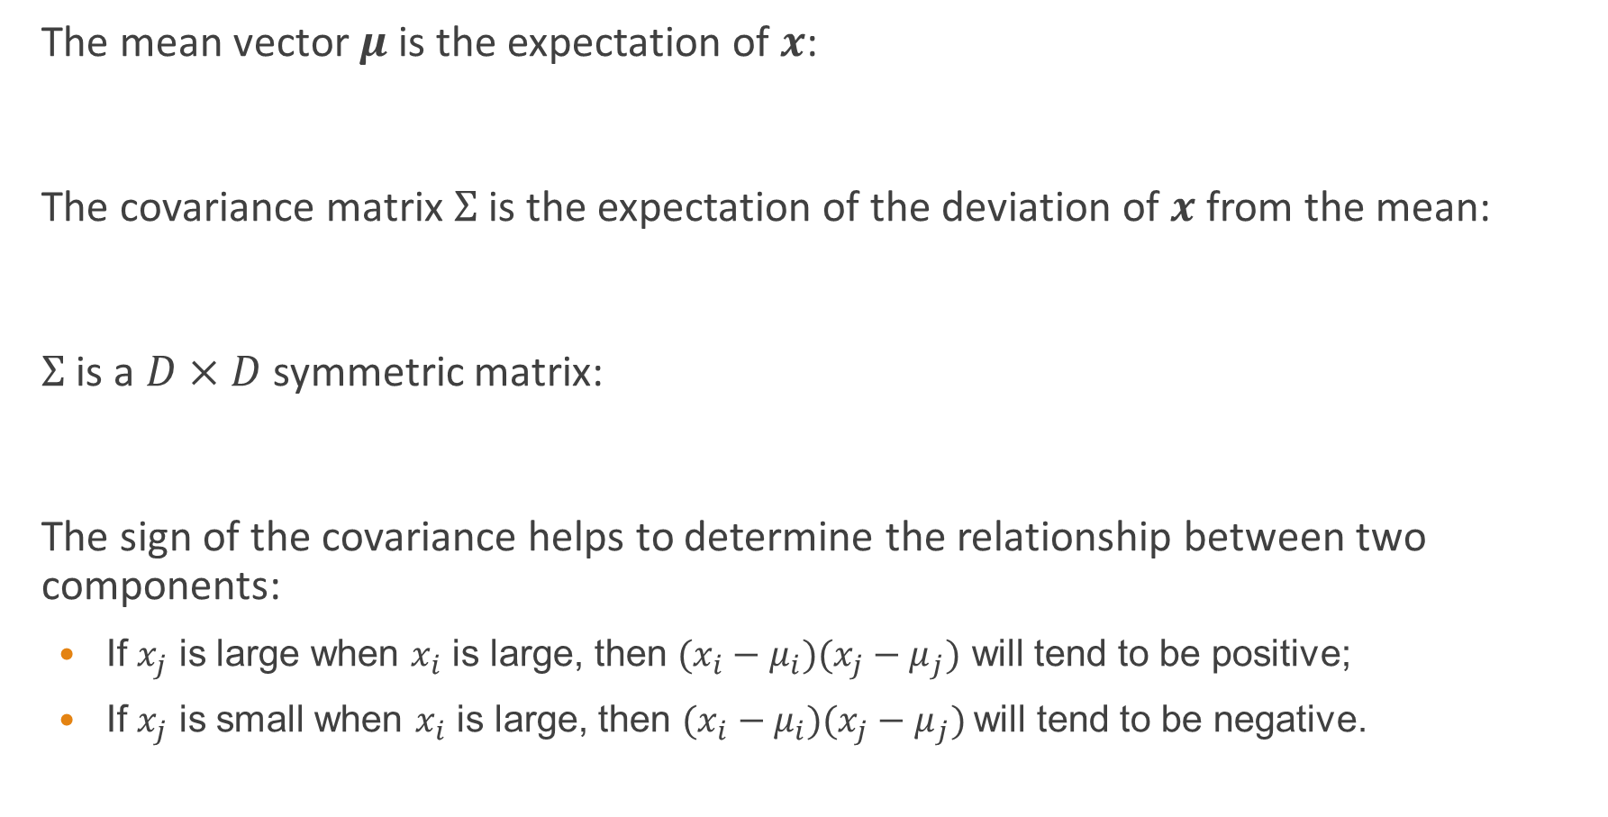

Covariance matrix
The mean vector $μ$ is the expectation of $x$:
The covariance matrix $Σ$ is the expectation of the deviation of $x$ from the mean:
$Σ$ is a $D×D$ symmetric matrix:
The sign of the covariance helps to determine the relationship between two components:
  If $x_{j}$ is large when $x_{i}$ is large, then $(x_{i}−μ_{i})(x_{j}−μ_{j})$ will tend to be positive;
  If $x_{j}$ is small when $x_{i}$ is large, then $(x_{i}−μ_{i})(x_{j}−μ_{j})$will tend to be negative.
$$μ=E\left[x\right]$$
$$Σ=E\left[\left(x−μ\right){\left(x−μ\right)}^{T}\right]$$
$$σ_{ij}=E\left[\left(x_{i}−μ_{i}\right)\left(x_{j}−μ_{j}\right)\right]=E\left[ \left(x_{j}−μ_{j}\right)\left(x_{i}−μ_{i}\right)\right]=σ_{ji}$$

Slide 13

Spherical Gaussian
$μ=\left(\begin{matrix}0 \\ 0\end{matrix}\right) Σ=\left(\begin{matrix}1 & 0 \\ 0 & 1\end{matrix}\right) ρ_{12}=0$
NB: Correlation coefficient $ρ_{ij}=\frac{σ_{ij}}{\sqrt{σ_{ii}σ_{jj}}} (−1≤ρ_{ij}≤1)$

Slide 14

Diagonal Covariance Gaussian
$μ=\left(\begin{matrix}0 \\ 0\end{matrix}\right) Σ=\left(\begin{matrix}1 & 0 \\ 0 & 4\end{matrix}\right) ρ_{12}=0$
NB: Correlation coefficient $ρ_{ij}=\frac{σ_{ij}}{\sqrt{σ_{ii}σ_{jj}}} (−1≤ρ_{ij}≤1)$

Slide 15

Full covariance Gaussian
$μ=\left(\begin{matrix}0 \\ 0\end{matrix}\right) Σ=\left(\begin{matrix}1 & −1 \\ −1 & 4\end{matrix}\right) ρ_{12}=−0.5$
NB: Correlation coefficient $ρ_{ij}=\frac{σ_{ij}}{\sqrt{σ_{ii}σ_{jj}}} (−1≤ρ_{ij}≤1)$

Slide 16

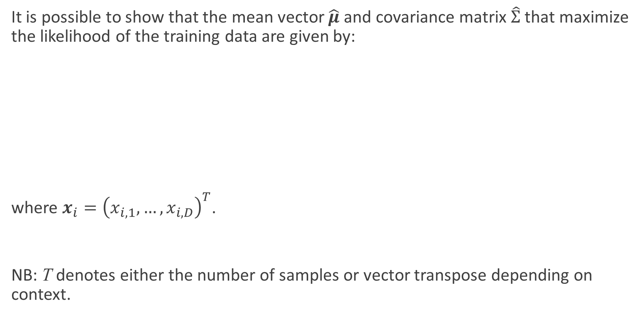
Parameter estimation of a multivariate Gaussian distribution
It is possible to show that the mean vector $\hat{μ}$ and covariance matrix $\hat{Σ}$ that maximize the likelihood of the training data are given by:
where $x_{i}={\left(x_{i,1},…,x_{i,D}\right)}^{T}$.
NB: T denotes either the number of samples or vector transpose depending on context.
$$\hat{μ}=\frac{1}{N}\sum_{t=1}^{N}{x_{n}}$$
$$\hat{Σ}=\frac{1}{N}\sum_{t=1}^{N}{{{(x}_{i}−\hat{μ}){(x}_{i}−\hat{μ})}^{T}}$$

Slide 17
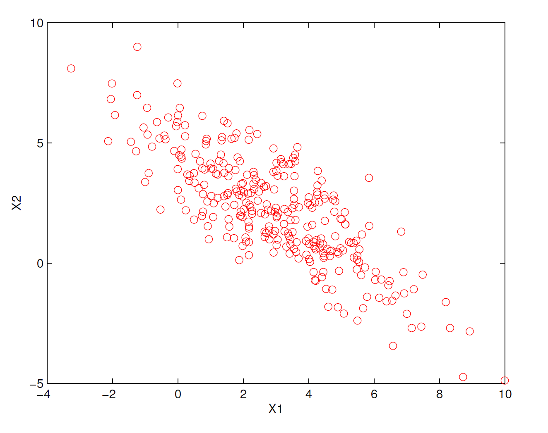
Example data

Slide 18
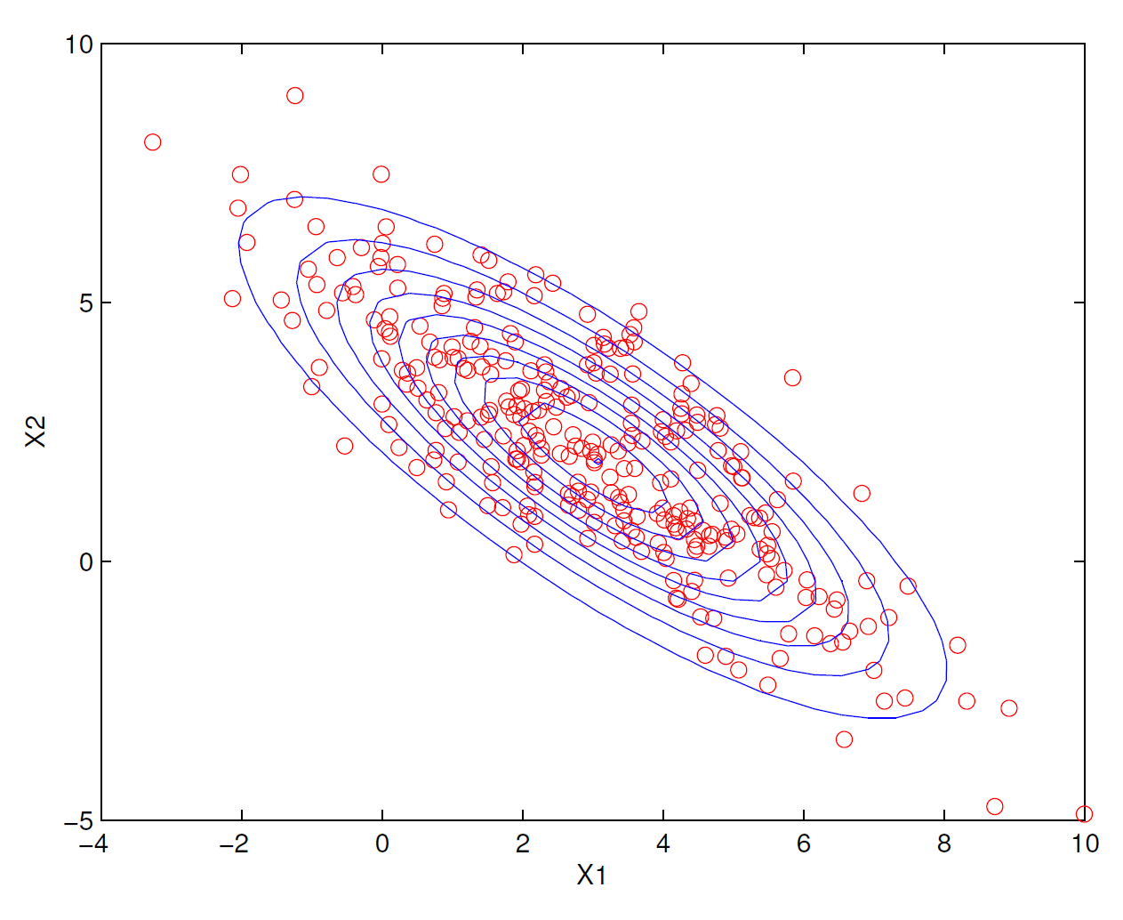
Maximum likelihood fit to a Gaussian

Slide 19
Data in clusters (example 1)
$$μ_{1}={\left(0,0\right)}^{T} μ_{2}={\left(1,1\right)}^{T} Σ_{1}=Σ_{2}=0.2I$$

Slide 20
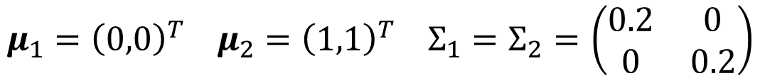
Example 1 fit by a Gaussian
$$μ_{1}={\left(0,0\right)}^{T} μ_{2}={\left(1,1\right)}^{T} Σ_{1}=Σ_{2}=\left(\begin{matrix}0.2 & 0 \\ 0 & 0.2\end{matrix}\right)$$

Slide 21
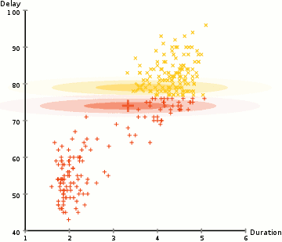
Cluster using Gaussian mixture model
Notes:
https://blog.csdn.net/lin_limin/article/details/81048411

Slide 22
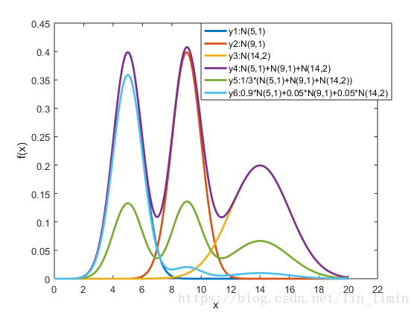
Cluster using Gaussian mixture model

Slide 23
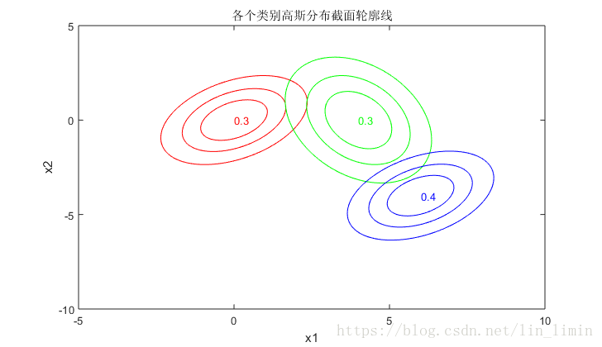
Cluster using Gaussian mixture model

Slide 24
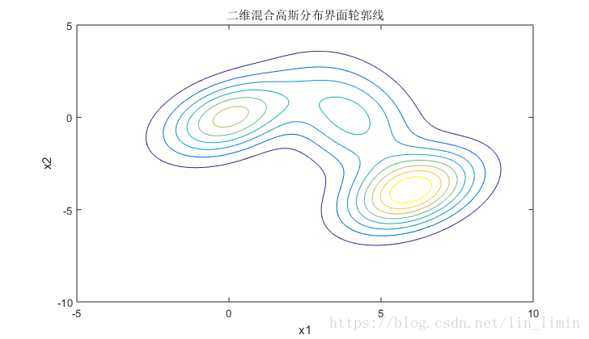
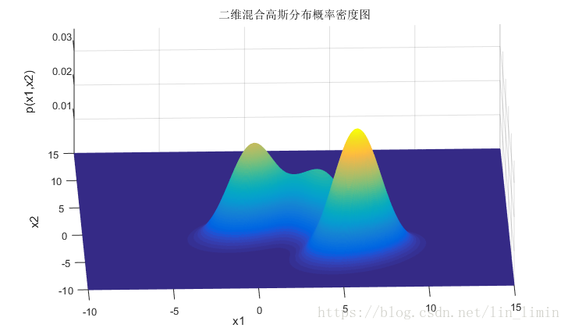
Cluster using Gaussian mixture model

Slide 25
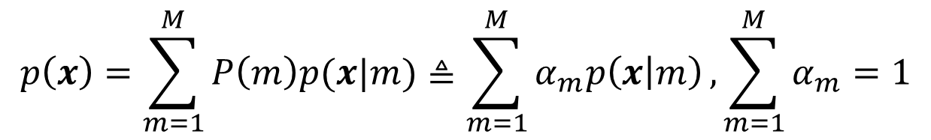
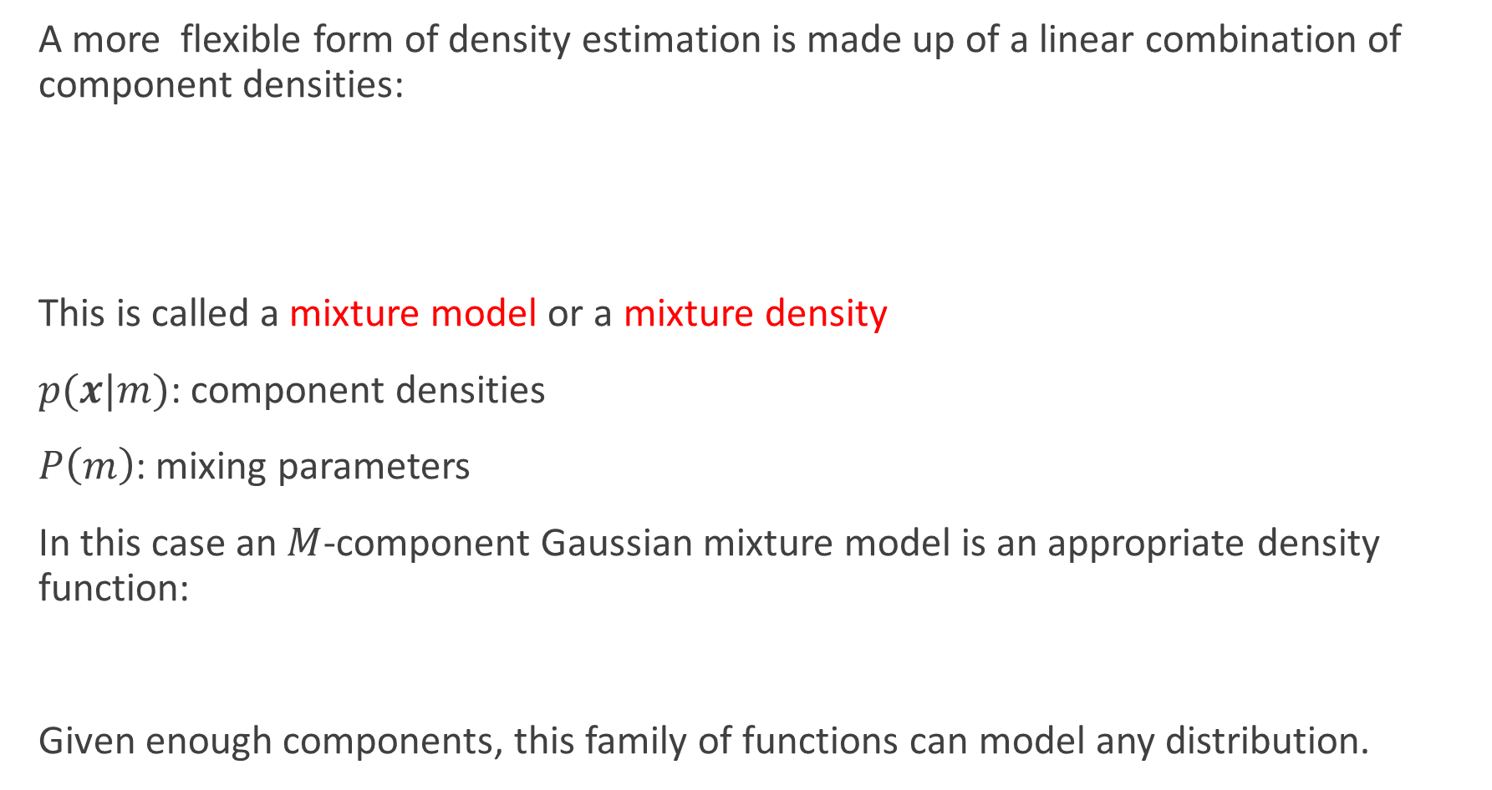
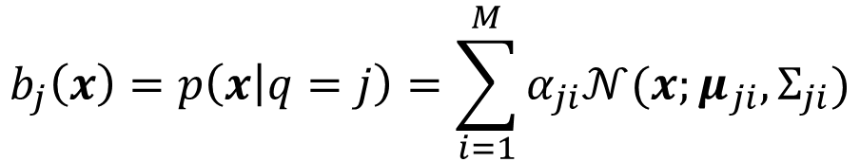
Gaussian mixture model
A more flexible form of density estimation is made up of a linear combination of component densities:
This is called a mixture model or a mixture density
$p(x|m)$: component densities
$P\left(m\right)$: mixing parameters
In this case an $M$-component Gaussian mixture model is an appropriate density function:
Given enough components, this family of functions can model any distribution.
$$p\left(x\right)=\sum_{m=1}^{M}{P\left(m\right)p(x|m)}≜\sum_{m=1}^{M}{α_{m}p\left(x | m\right)},\sum_{m=1}^{M}{α_{m}}=1$$
Mixture coefficient
$$b_{j}\left(x\right)=p\left(x | q=j\right)=\sum_{i=1}^{M}{α_{ji}𝒩(x;μ_{ji},Σ_{ji})}$$

Slide 26
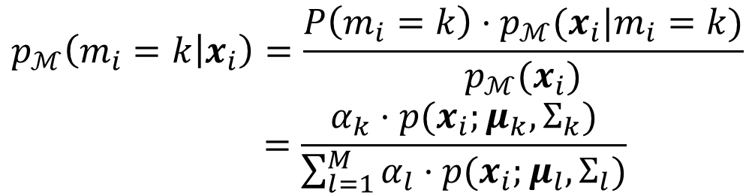
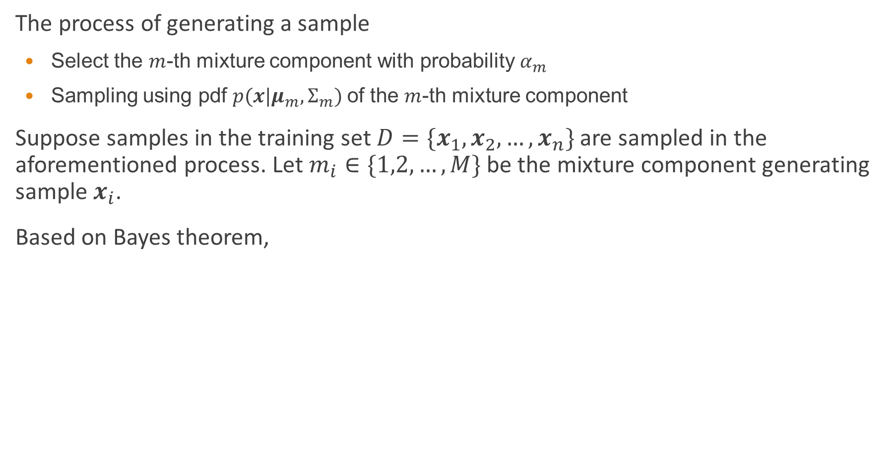

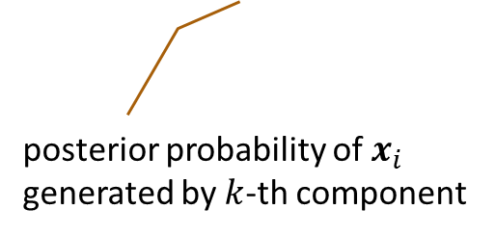
Gaussian mixture model
The process of generating a sample
  Select the $m$-th mixture component with probability $α_{m}$
  Sampling using pdf $p(x|μ_{m},Σ_{m})$of the $m$-th mixture component
Suppose samples in the training set $D=\{x_{1},x_{2},…,x_{n}\}$ are sampled in the aforementioned process. Let $m_{i}∈\{1,2,…,M\}$ be the mixture component generating sample $x_{i}$.
Based on Bayes theorem,
$$p_{ℳ}\left(m_{i}=k | x_{i}\right)=\frac{P\left(m_{i}=k\right)⋅p_{ℳ}(x_{i}|m_{i}=k)}{p_{ℳ}(x_{i})}$$
$$=\frac{α_{k}⋅p(x_{i};μ_{k},Σ_{k})}{\sum_{l=1}^{M}{α_{l}⋅p(x_{i};μ_{l},Σ_{l})}}$$
$$γ_{ji}$$
posterior probability of $x_{i}$ generated by $k$-th component

Slide 27


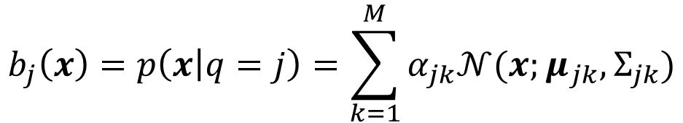
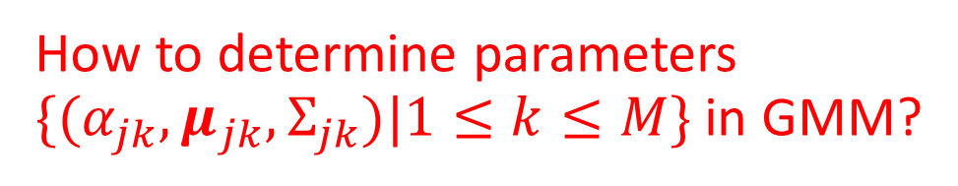
Gaussian mixture model
If $α_{jk},μ_{jk},Σ_{jk}$ are known, $b_{j}(x)$ can be easily computed
However, $α_{jk},μ_{jk},Σ_{jk}$ are unknown
Complete data: $(x_{j},γ_{j1},γ_{j2},…,γ_{jk})$
$$b_{j}\left(x\right)=p\left(x | q=j\right)=\sum_{k=1}^{M}{α_{jk}𝒩(x;μ_{jk},Σ_{jk})}$$
How to determine parameters $\{(α_{jk},μ_{jk},Σ_{jk})|1≤k≤M\}$ in GMM?

Slide 28
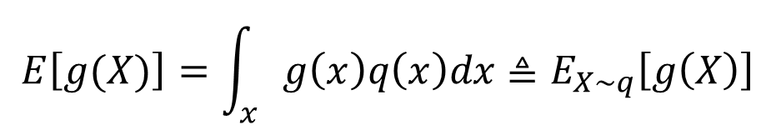

The expected value of a function
Let $X$ be a random variable whose PDF is $q(x)$, and $g$ a function of random variable $X$.
The expected value of $g(x)$ is
$$E\left[g(X)\right]=\int_{x}{g\left(x\right)q\left(x\right)dx}≜E_{X\sim q}\left[g\left(X\right)\right]$$

Slide 29
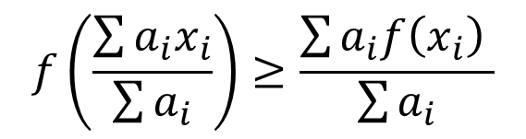
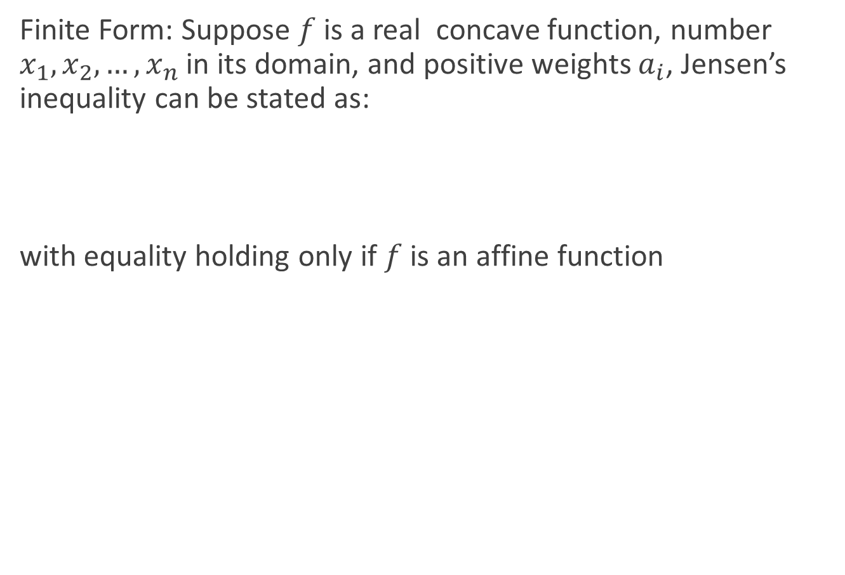



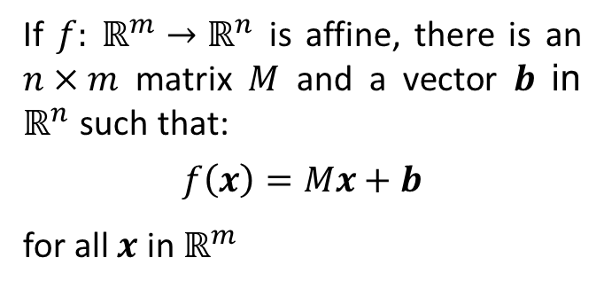
Pre-requisite: Jensen’s inequality
Finite Form: Suppose $f$ is a real concave function, number $x_{1}, x_{2}, …, x_{n}$ in its domain, and positive weights $a_{i}$, Jensen’s inequality can be stated as:
with equality holding only if $f$ is an affine function
$$f\left(\frac{\sum{a_{i}x_{i}}}{\sum{a_{i}}}\right)≥\frac{\sum{a_{i}f\left(x_{i}\right)} }{\sum{a_{i}}}$$
If $f: ℝ^{m}→ℝ^{n}$ is affine, there is an $n×m$ matrix $M$ and a vector $b$ in $ℝ^{n}$ such that:
$$f\left(x\right)=Mx+b$$
for all $x$ in $ℝ^{m}$
$$f(λx_{1}+\left(1−λ\right)x_{2})$$
$$λf\left(x_{1}\right)+\left(1−λ\right)f(x_{2})$$
$$a_{1}=λ,a_{2}= 1−λ⇒$$
Notes:
$$\log\left(\frac{\sum_{i=1}^{n}{x_{i}}}{n}\right)≥\frac{\sum_{i=1}^{n}{\log\left(x_{i}\right)}}{n}⇒\frac{x_{1}+x_{2}+…+x_{n}}{n}≥\sqrt[n]{x_{1}+x_{2}+…+x_{n}}$$

Slide 30
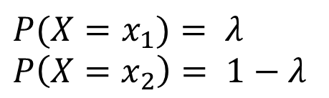
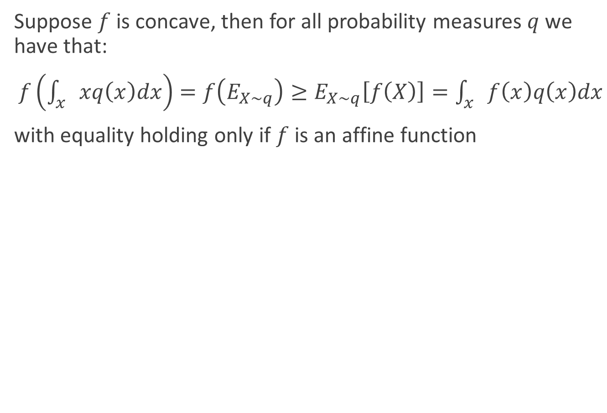



Pre-requisite: Jensen’s inequality
Suppose $f$ is concave, then for all probability measures $q$ we have that:
$f\left(\int_{x}{xq\left(x\right)dx}\right)=f\left(E_{X\sim q}\right)≥E_{X\sim q}\left[f\left(X\right)\right]=\int_{x}{f\left(x\right)q\left(x\right)dx}$
with equality holding only if $f$ is an affine function
Illustration:
$$f(λx_{1}+\left(1−λ\right)x_{2})$$
$$P(X=x_{1})= λ$$
$$P\left(X=x_{2}\right)= 1−λ$$
$$λf\left(x_{1}\right)+\left(1−λ\right)f(x_{2})$$
$$E[X] =λx_{1}+\left(1−λ\right)x_{2}$$

Slide 31

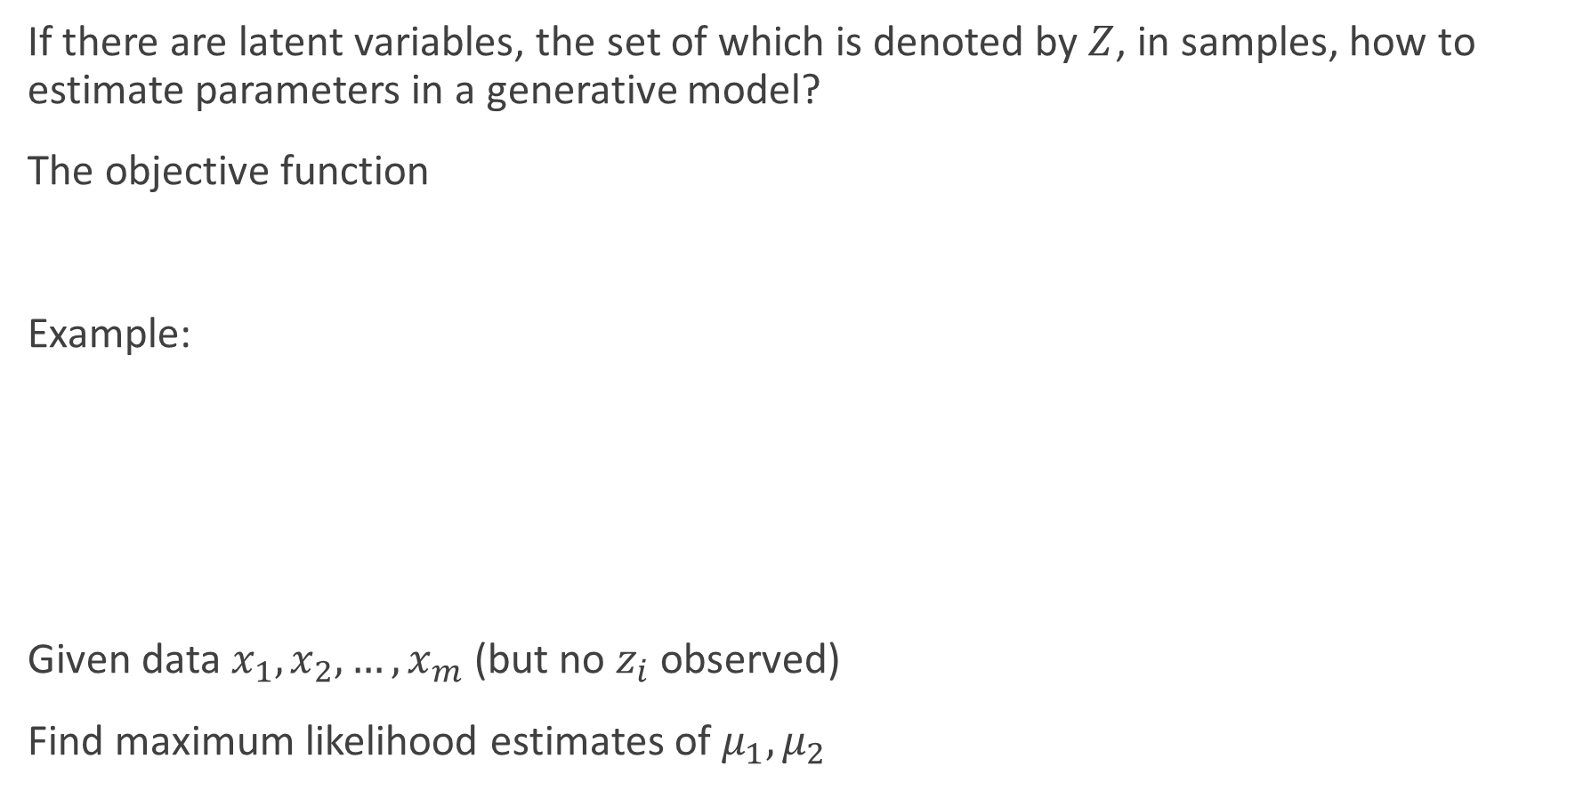
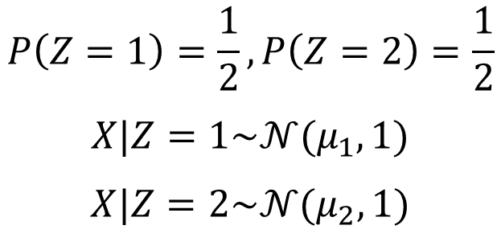
Pre-requisite: EM algorithm
If there are latent variables, the set of which is denoted by $Z$, in samples, how to estimate parameters in a generative model?
The objective function
Example:
Given data $x_{1},x_{2},…,x_{m}$ (but no $z_{i}$ observed)
Find maximum likelihood estimates of $μ_{1},μ_{2}$
$$LL\left(θ | X,Z\right)=\ln{P(X,Z|θ)}$$
$$P\left(Z=1\right)=\frac{1}{2},P\left(Z=2\right)=\frac{1}{2}$$
$$X|Z=1\sim 𝒩(μ_{1},1)$$
$$X|Z=2\sim 𝒩(μ_{2},1)$$

Slide 32

Pre-requisite: EM algorithm
EM basic idea: if $Z$ were known $→$ two easy-to-solve separate ML problems
EM iterates over
  E-step: For $i=1,…,m$fill in missing data $z_{i}$ according to what is most likely given the current model $μ$
  M-step: run ML for completed data, which gives new model $μ$

Slide 33
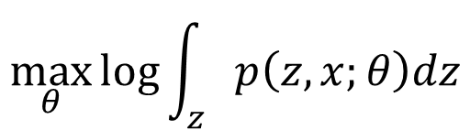

Pre-requisite: EM algorithm
EM solves a Maximum Likelihood problem of the form
$θ$: parameters of the probabilistic model we try to find
$z$: unobserved variables
$x$: observed variables
$$\max_{θ}{\log{\int_{z}{p\left(z,x;θ\right)dz}}}$$

Slide 34

Pre-requisite: EM algorithm
$$\max_{θ}{\log{\int_{z}{p\left(z,x;θ\right)dz}}}=\max_{θ}{\log{\int_{z}{p\left(z,x;θ\right)\frac{q\left(z\right)}{q\left(z\right)}dz}}}$$
$$=\max_{θ}{\log{\int_{z}{\frac{p\left(z,x;θ\right)}{q\left(z\right)}q\left(z\right)dz}}}$$
$$=\max_{θ}{\log{E_{X\sim q}\left[\frac{p\left(Z,x;θ\right)}{q\left(Z\right)}\right]}}$$
$$≥\max_{θ}{E_{X\sim q}\log\left[\frac{p\left(Z,x;θ\right)}{q\left(Z\right)}\right]}$$
$$=\max_{θ}{\int_{z}{q\left(z\right)\log{p\left(z,x;θ\right)}dz}}$$
$$−\int_{z}{q\left(z\right)\log{q\left(z\right)}dz}$$
Jensen’s Inequality

Slide 35



Pre-requisite: EM algorithm
$$\max_{θ}{\log{\int_{z}{p\left(z,x;θ\right)dz}}}≥\max_{θ}{\int_{z}{q\left(z\right)\log{p\left(z,x;θ\right)}dz}}−\int_{z}{q\left(z\right)\log{q\left(z\right)}dz}$$
Jensen’s Inequality: equality holds when is an affine function
This is achieved for $q\left(z\right)=p(z|x;θ)∝p\left(z,x;θ\right)$
$$f\left(z\right)=\log{\frac{p\left(z,x;θ\right)}{q(z)}}$$
EM Algorithm: Iterate
1. E-step: Compute $q\left(z\right)=p(z|x;θ)$
2. M-step: Compute $θ=\arg{\max_{θ}{\int_{z}{q\left(z\right)\log{p\left(z,x;θ\right)}dz}}}$

Slide 36

Pre-requisite: EM algorithm

Slide 37



Gaussian mixture model
E-step:
M-step:
$$γ_{ji}=p_{ℳ}\left(z_{j}=i | x_{j};α_{i},μ_{i},Σ_{i}\right) =\frac{p_{ℳ}({z_{j}=i,x}_{j};α_{i},μ_{i},Σ_{i})}{p_{ℳ}(x_{j};α_{i},μ_{i},Σ_{i})}$$
$$=\frac{α_{i}⋅p(x_{j};μ_{i},Σ_{i})}{\sum_{l=1}^{k}{α_{l}⋅p(x_{j};μ_{l},Σ_{l})}}$$
$$\max_{α,μ,Σ}{\sum_{j=1}^{n}{\sum_{i=1}^{k}{γ_{ji}\log{(α_{i}⋅p(x_{j};μ_{i},Σ_{i})\text{)}}}}}≜\max_{α,μ,Σ}{L\left(α,μ,Σ\right)}$$

Slide 38





Cluster using Gaussian mixture model
For $α_{i}$, there are two constraints: 1) $α_{i}≥0$; 2) $\sum_{i=1}^{k}{α_{i}}=1$
Construct a Lagrange function $F\left(α,λ\right)$
$$F\left(α,λ\right)=L(α)+λ\left(\sum_{i=1}^{k}{α_{i}}−1\right)$$
$$\frac{∂F}{∂α_{i}}=0⇒\frac{\sum_{j=1}^{n}{γ_{ji}}}{α_{i}}+λ=0$$
$$\left.\begin{matrix}\begin{matrix} \\ \end{matrix} \\ \begin{matrix} \\ \end{matrix}\end{matrix}\right\}⇒α_{i}=\frac{1}{n}\sum_{j=1}^{n}{γ_{ji}}$$
$$λ=−n$$

Slide 39





Cluster using Gaussian mixture model
If $\{(α_{i},μ_{i},Σ_{i})|1≤i≤k\}$ maximize $LL\left(D\right)$ $⇒$
Similarly,
$$\frac{∂L}{∂μ_{i}}=0⇒\frac{∂(\sum_{j=1}^{n}{γ_{ji}}\log{(a_{i}p(x_{j};μ_{i},Σ_{i}))})}{∂μ_{i}}=0$$
$$⇒\frac{∂(\sum_{j=1}^{n}{γ_{ji}}\log{(p(x_{j};μ_{i},Σ_{i}))})}{∂μ_{i}}=0$$
$$⇒μ_{i}=\frac{\sum_{j=1}^{m}{γ_{ji}x_{j}}}{\sum_{j=1}^{m}{γ_{ji}}}$$
$$\frac{∂L}{∂Σ_{i}}=0⇒Σ_{i}=\frac{\sum_{j=1}^{m}{γ_{ji}\left(z_{j}−μ_{i}\right){\left(z_{j}−μ_{i}\right)}^{T}}}{\sum_{j=1}^{m}{γ_{ji}}}$$

Slide 40

Cluster using Gaussian mixture model
EM algorithm in GMM
E step:
  Compute posterior probability $γ_{ji}$ using current parameters
M step:
  Update parameters $\{(α_{i},μ_{i},Σ_{i})\}$

Slide 41

Cluster using Gaussian mixture model
Notes:
补充：Mean-Shift算法

Slide 42



Soft assignment
We can view the EM algorithm as estimating “soft counts” for the data points, based on the component occupation probabilities $P(m|x_{i})$:
We can imagine this as assigning data points to component $m$ weighted by the component occupation probability $P(m|x_{t})$
Estimate the mean, variance and prior probabilities as:
$$N_{m}^{∗}=\sum_{n=1}^{N}{P(m|x_{i})}$$
$${\hat{μ}}_{m}=\frac{\sum_{i}{P\left(m | x_{i}\right)x_{i}}}{\sum_{i}{P\left(m | x_{i}\right)}}=\frac{\sum_{i}{P\left(m | x_{i}\right)x_{i}}}{N_{m}^{∗}}$$
$${\hat{σ}}_{m}^{2}=\frac{\sum_{n}{P\left(m | x_{i}\right){\left\|x_{i}−{\hat{μ}}_{m}\right\|}^{2}}}{\sum_{n}{P\left(m | x_{i}\right)}}=\frac{\sum_{n}{P\left(m | x_{i}\right){\left\|x_{i}−{\hat{μ}}_{m}\right\|}^{2}}}{N_{m}^{∗}}$$
$$P\left(m\right)=\frac{1}{n}\sum_{i}{P(m|x_{i})}=\frac{N_{m}^{∗}}{n}$$

Slide 43
Comments on GMMs
GMMs trained using the EM algorithm are able to self organize to fit a data set
Individual components take responsibility for parts of the data set (probabilistically)
Soft assignment to components not hard assignment “soft clustering”
GMMs scale very well
  e.g.: large speech recognition systems can have 30,000 GMMs, each with 32 components: sometimes 1 million Gaussian components!! And the parameters all estimated from (a lot of) data by EM

Slide 44




HMMs with Gaussian observation probabilities
We can use a Gaussian distribution to model the observation probability:
We need to estimate parameters ${\hat{μ}}_{j}$, ${\hat{Σ}}_{j}$ for each state $j$ . Use the EM algorithm to weight each sample $x_{t}$ by the occupation probability $γ_{t}^{j}$:
And likewise for the covariance matrices:
$$b_{j}\left(x\right)=𝒩(x;μ_{j},Σ_{j})$$
$${\hat{μ}}_{j}=\frac{\sum_{t=1}^{T}{γ_{t}^{j}x_{t}}}{\sum_{t=1}^{T}{γ_{t}^{j}}}$$
$${\hat{Σ}}_{j}=\frac{\sum_{t=1}^{T}{γ_{t}^{j}\left(x_{t}−{\hat{μ}}_{j}\right){\left(x_{t}−{\hat{μ}}_{j}\right)}^{T} }}{\sum_{t=1}^{T}{γ_{t}^{j}}}$$

Slide 45


Extension to Gaussian mixture model (GMM)
The assumption of a Gaussian distribution at each state is very strong; in practice the acoustic feature vectors associated with a state may be strongly non-Gaussian
In this case a $k$-component Gaussian mixture model is an appropriate density function:
Given enough components, this family of functions can model any distribution.
Train using the EM algorithm again, in which the component occupation probabilities are estimated along with the state occupation probabilities in the E-step
$$b_{j}\left(x\right)=p\left(x | q=j\right)=\sum_{i=1}^{k}{α_{ji}𝒩(x;μ_{ji},Σ_{ji})}$$

Slide 46



EM training of HMM/GMM
Rather than estimating the state-time alignment, we estimate the component/state-time alignment, and component-state occupation probabilities $γ_{t}^{jm}$: the probability of occupying mixture component m of state $j$ at time $t$.
Re-estimate the parameters of component $m$ of state $j$ as follows
The mixture coefficients are re-estimated in a similar way to transition probabilities:
$${\hat{μ}}_{jm}=\frac{\sum_{t=1}^{T}{γ_{t}^{jm}x_{t}}}{\sum_{t=1}^{T}{γ_{t}^{jm}}}$$
$${\hat{Σ}}_{jm}=\frac{\sum_{t=1}^{T}{γ_{t}^{jm}\left(x_{t}−{\hat{μ}}_{jm}\right){\left(x_{t}−{\hat{μ}}_{jm}\right)}^{T} }}{\sum_{t=1}^{T}{γ_{t}^{jm}}}$$
$${\hat{α}}_{jm}=\frac{\sum_{t=1}^{T}{γ_{t}^{jm}}}{\sum_{m^{′}=1}^{M}{\sum_{t=1}^{T}{γ_{t}^{jm}}}}$$

Slide 47
Doing the computation
The forward, backward and Viterbi recursions result in a long sequence of probabilities being multiplied
This can cause floating point underflow problems In practice computations are performed in the log domain (in which multiplies become adds)
Working in the log domain also avoids needing to perform the exponentiation when computing Gaussians

